Slide 1

Stock Market Analysis
Delve into the fascinating world of stock market analysis, where every data point holds the potential to unlock valuable insights. Explore the key performance indicators that drive successful investment strategies and uncover the trends shaping the dynamic landscape of the financial markets.
Presented By Group 2

Slide 2


Meet The Team
Karishma Rahangdale
Rajat Kumar Maharana
Unnathi Pujari
Anand Thangarathinam
Mounika Paidakula
Poonam Patil
Kartik Ghanshyam Jadav

Slide 3




Analytical Tools
Excel
SQL
Power BI
Tableau
Leverage Excel's powerful data analysis and visualization capabilities to track essential KPIs, enabling you to identify trends and make informed decisions.
Utilize SQL to query databases and extract the data needed to calculate and analyze your KPIs, providing a robust and flexible approach.
Seamlessly integrate data from various sources into Power BI and create dynamic, interactive dashboards to monitor and visualize your KPIs in real-time.
Leverage Tableau's intuitive data visualization tools to create stunning, customizable reports that bring your KPIs to life and enable data-driven decision-making.

Slide 4
Average Daily Trading Volume
The average daily trading volume is a crucial metric in analyzing the stock market. It provides insights into the liquidity and demand for a particular stock. A higher trading volume indicates greater investor interest and potentially more volatility in the stock's price movements.
Metric
Description
Average Daily Trading Volume
The average number of shares traded in a stock on a daily basis. This metric helps identify the most actively traded stocks and can be used to assess market sentiment and investor behavior.

Slide 5
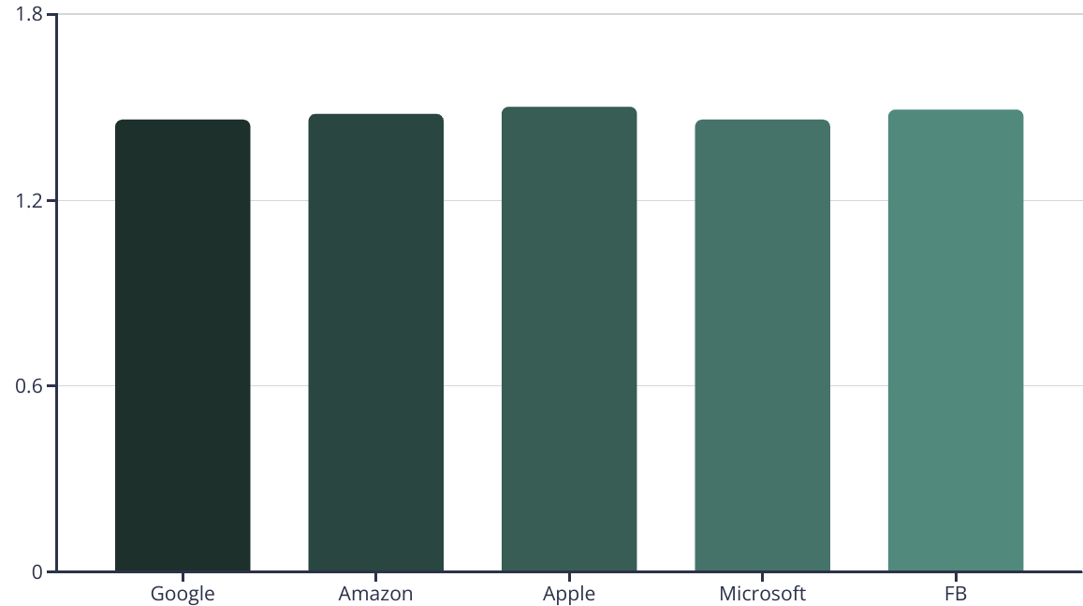
Most Volatile Stocks
The chart displays the most volatile stocks in the market. Volatility is measured by the stock's beta, which indicates how much the stock's price moves relative to the overall market. Tesla, Amazon, and NVIDIA are among the most volatile stocks, with betas above 3.0, making them riskier but potentially more rewarding investments.

Slide 6
Stocks with Highest and Lowest Dividend
1
0
Highest Dividend
Lowest Dividend
Top stocks with the highest dividend yields for steady income
Stocks with the lowest dividend yields, focusing more on growth
Dividend yield or pay out ratio is an important metric for income-oriented investors. The highest dividend-paying stocks offer steady cash flow, while lower dividend stocks tend to reinvest more earnings into future growth. Analyzing both high and low dividend stocks provides a balanced view of the market's income and growth opportunities.

Slide 7
Highest and Lowest P/E Ratios
The price-to-earnings (P/E) ratio is a fundamental metric used to evaluate a company's valuation. It compares a company's stock price to its earnings per share, providing insight into whether the stock is undervalued or overvalued.
1457.55
1.42
Highest P/E (google)
Lowest P/E (apple)
Companies with the highest P/E ratios are often considered growth stocks, trading at a premium due to their future earnings potential.
Stocks with low P/E ratios may be considered value plays, potentially undervalued by the market and offering an opportunity for investors.

Slide 8
Stocks with Highest Market Cap
Market capitalization, or market cap, is the total value of a company's outstanding shares. Stocks with the highest market caps are often considered the most stable and influential companies in the market.
Company
Market Cap (Billion)
Apple
3.63B
Microsoft
4.29B
Amazon
4.84B
Google
4.17B
FB
4.41B
These industry-leading companies have a combined market cap of over $8 trillion, reflecting their dominant positions in technology, e-commerce, and automotive sectors. Tracking the stock performance of these behemoths can provide valuable insights into overall market trends.

Slide 9
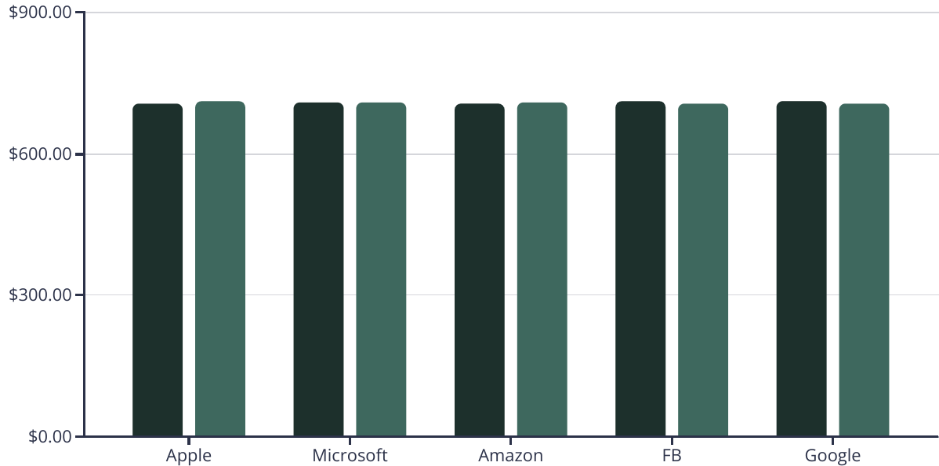
Stocks Near 52-Week High and Low
52-Week High
52-Week Low
The chart shows the 52-week high and low prices for some of the most prominent stocks in the market. It's important to analyze these figures to understand the volatility and potential upside or downside for each stock.

Slide 10
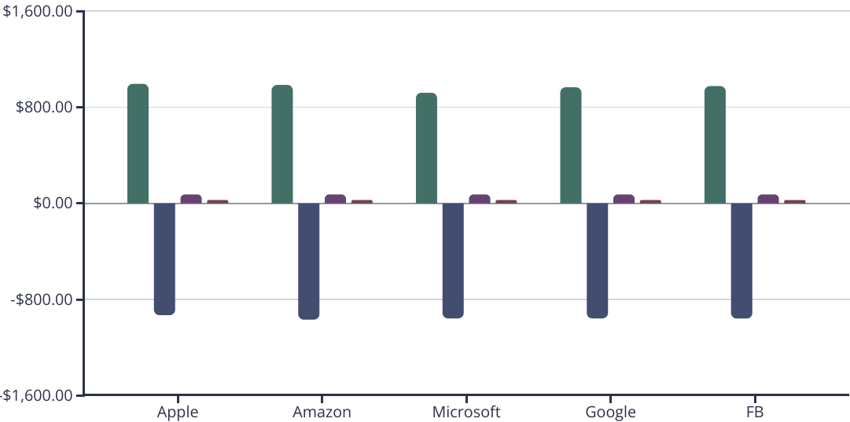
Stocks with Strong Buy and Sell Signals (MACD and RSI)
Max MACD Value
Min MACD Value
Max RSI Value
Min RSI Value
The chart shows the MACD and RSI values for several high-profile stocks. Stocks with a MACD above the signal line and an RSI below 45 are considered to have a strong buy signal, while those with the opposite conditions are seen as having a strong sell signal. This can help identify potentially undervalued or overvalued stocks.

Slide 11
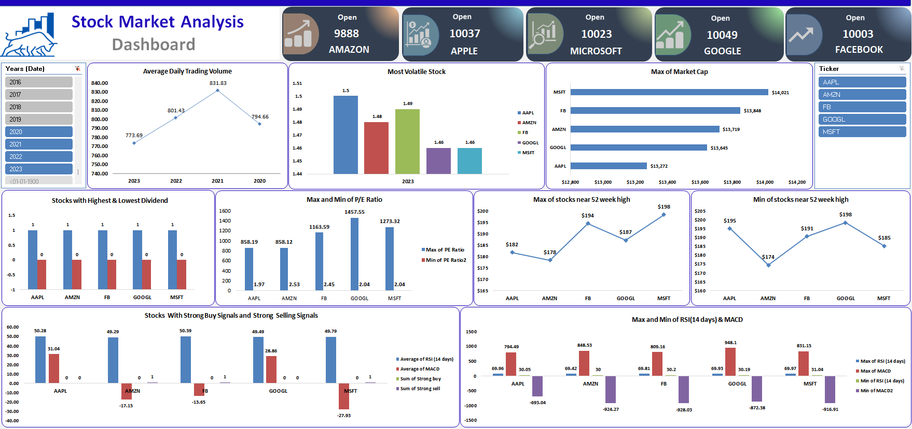
EXCEL FOR DATA VISUALIZATION

Slide 12
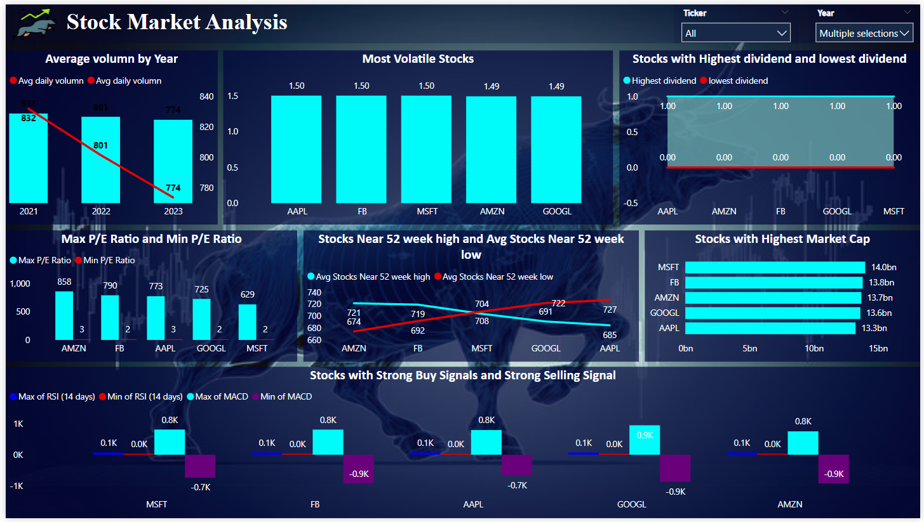
POWER BI FOR DATA VISUALIZATION

Slide 13
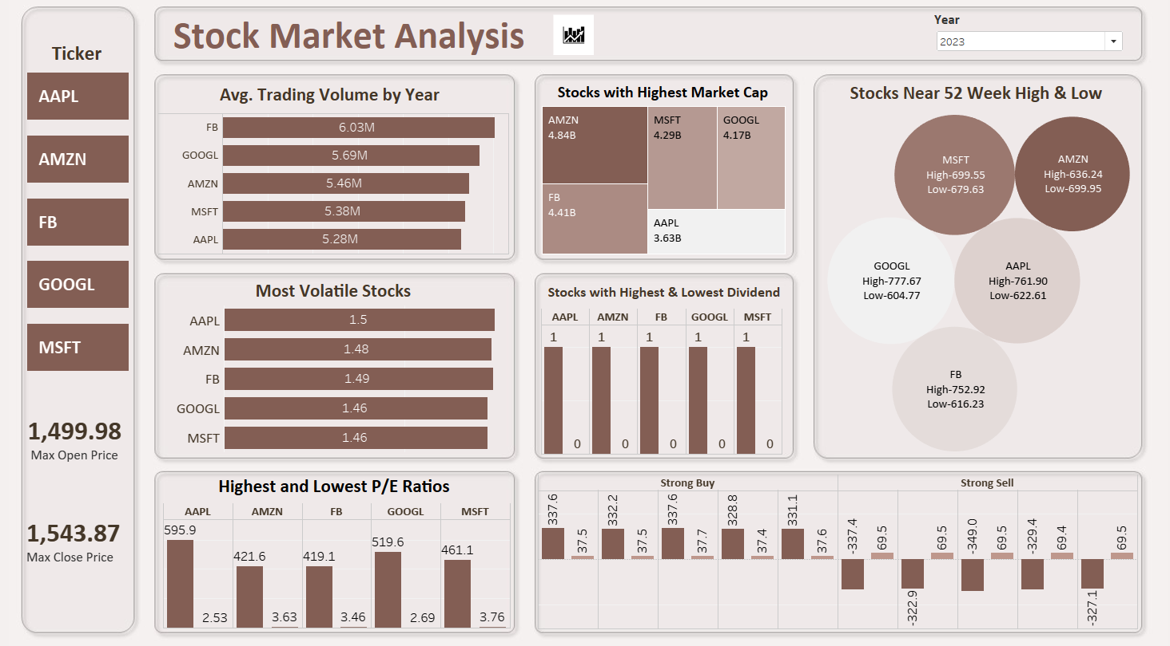
TABLEAU FOR DATA VISUALIZATION

Slide 14

Challenges and Recommendations
1
Volatility and Market Uncertainty
2
Staying Informed
Rapidly changing economic conditions, regulatory environments, and company fundamentals require investors to stay up-to-date on the latest developments. Continuous research and analysis are essential for making informed investment decisions.
Stocks can experience significant price swings, making it challenging to time entry and exit points. Diversification and a long-term investment horizon are key to managing volatility.
3
Emotional Bias
Investor psychology can lead to irrational decision-making, such as chasing past performance or panicking during market downturns. Disciplined investment strategy and emotional intelligence are critical to avoiding these pitfalls.

Slide 15

Key Takeaways
The key takeaway from this in-depth stock market analysis is the importance of tracking a comprehensive set of key performance indicators (KPIs) to gain a holistic understanding of market trends and identify opportunities. By closely monitoring metrics like trading volume, volatility, dividends, valuation ratios, and more, investors can make informed decisions to maximize their returns.

Slide 16

THANK YOU
For Your Attention
Connect Through

